Slide 1
FAKE NEWS DETECTION
Team Name/No:
Gursahaj Singh 2210990349
Harjot Singh 2210990363
Harkaran Singh 2210990364
Jaikirat Dev 2210990428

Slide 2
Index
Objective
Introduction
Methodology, Approach & Techniques
Algorithm
Conclusion
Reference

Slide 3
Objective
The goals of fake news detection generally involve:
Identification: Recognizing and categorizing news articles or content that may be false or misleading.
Verification: Confirming the accuracy and reliability of news sources, assertions, or information presented in articles or content.
Fact-Checking: Cross-referencing claims or information with credible sources or databases to ascertain their truthfulness.
Detection of Misinformation: Identifying and highlighting false or misleading information, including manipulated images, videos, or quotations.
Prevention: Taking measures to hinder the dissemination of fake news, such as content moderation, labeling, or deletion.
Education: Teaching users how to identify and critically evaluate news sources and information to mitigate the impact of fake news.
Algorithmic Detection: Creating algorithms or machine learning models to automatically identify patterns or features associated with fake news.
Collaboration: Encouraging cooperation between fact-checking organizations, news outlets, tech firms, and researchers to effectively combat fake news.
These aims aim to foster trustworthiness and integrity in news reporting and to minimize the detrimental effects of
misinformation on individuals and society.

Slide 4
Introduction
"In an era inundated with information from various sources, the proliferation of fake news has emerged as a critical challenge undermining the integrity of public discourse and decision-making processes. To address this pressing issue, our fake news detection program leverages advanced technologies and methodologies to identify, verify, and combat misinformation circulating across digital platforms. By combining cutting-edge algorithms, machine learning techniques, and collaborative efforts with reputable fact-checking organizations, our program aims to empower users with the tools and knowledge necessary to discern credible information from deceptive content. Through a multifaceted approach encompassing detection, verification, education, and prevention, we endeavor to safeguard the integrity of news dissemination and promote informed civic engagement in the digital age."

Slide 5
Methodology , Approach & Techniques
Methodology:
The methodology for fake news detection encompasses data collection, preprocessing, and feature extraction to prepare the data for analysis. Machine learning models are trained and evaluated using labeled datasets, with techniques like ensemble methods and cross-validation enhancing their accuracy. Human-in-the-loop approaches, user behaviour analysis, and real-time monitoring are employed for ongoing refinement and adaptation to combat evolving misinformation.
Approach :
Fake news detection programs utilize diverse approaches, including content and source analysis, user engagement scrutiny, and machine learning. These methods aim to discern misinformation by examining text, source credibility, and user interactions, thereby enhancing accuracy. Integration of cross-referencing, semantic analysis, and network evaluation further bolsters these programs' efficacy in identifying and mitigating fake news dissemination.
Techniques :
Fake news detection programs utilize content, source, and user engagement analysis alongside machine learning to discern misinformation. Cross-referencing and semantic analysis verify claims, while network analysis identifies influential nodes in misinformation dissemination. These techniques collectively bolster the efficacy of fake news detection systems in combat.

Slide 6
Algorithm
An algorithm for fake news detection typically involves several steps:
Data Collection: Gather a dataset comprising news articles, social media posts, or other textual content.
Preprocessing: Clean and preprocess the data by removing noise, stop words, and special characters, and performing tokenization and normalization.
Feature Extraction: Extract relevant features from the text, such as word frequencies, n-grams, and metadata like publishing source and date.
Model Training: Train a machine learning model, such as a classifier (e.g., Logistic Regression, Random Forest, or Neural Network), using the labeled dataset. The labels indicate whether the content is real or fake news.
Evaluation: Evaluate the performance of the trained model using metrics like accuracy, precision, recall, and F1-score on a separate validation dataset.
Testing: Test the trained model on new, unseen data to assess its effectiveness in detecting fake news.
Deployment: Deploy the trained model in a production environment where it can automatically classify news articles or social media posts as real or fake.
Monitoring and Updating: Continuously monitor the performance of the model in real-time and update it periodically with new data to adapt to evolving trends and tactics used by misinformation spreaders.

Slide 7
Algorithm Used
Algorithms Used for Training ,Testing and Predictions:
Logistic Regression
Decision Tree Classifier
RandomForestClassifier
Gradient Boosting Classifier

Slide 8
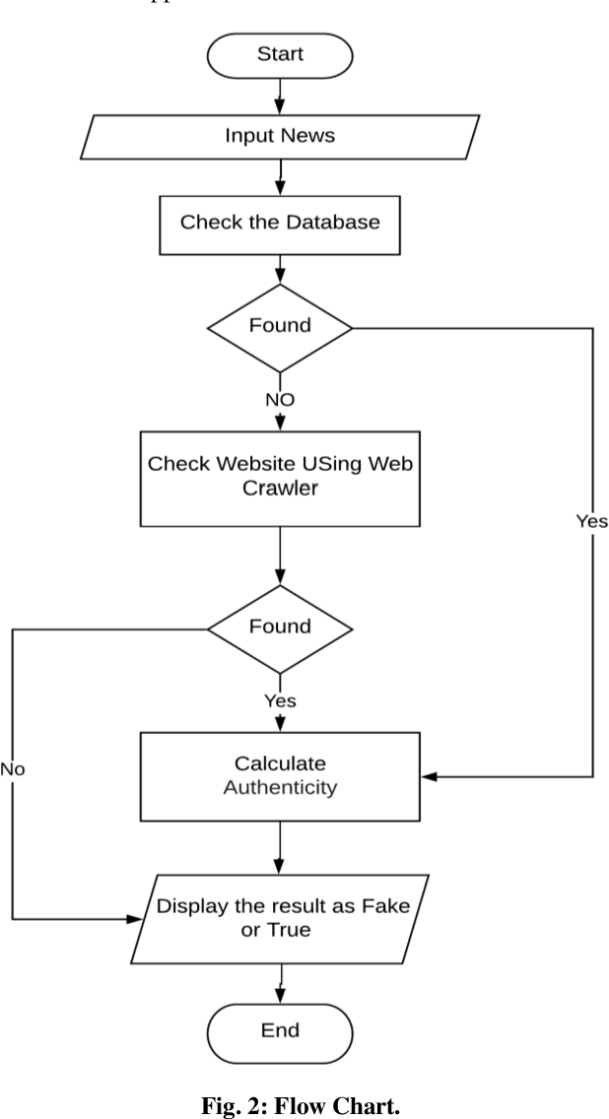
Flowchart

Slide 9


Interface

Slide 10
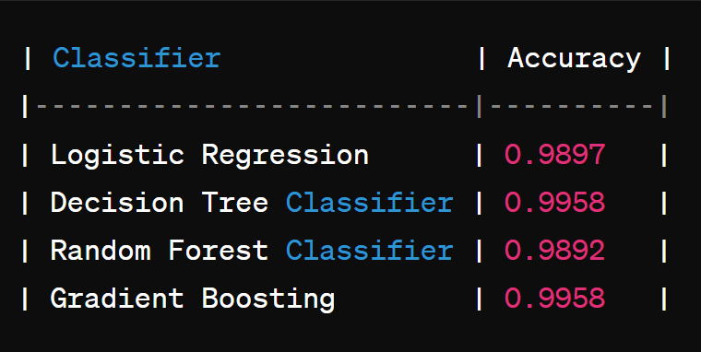
Result
Both the Decision Tree Classifier and the Gradient Boosting Classifier have the highest accuracy score of 0.9958
22CS016

Slide 11
Conclusion
In conclusion, the detection of fake news is a multifaceted challenge that requires a combination of technological, analytical, and human-driven approaches. While algorithms and machine learning play a crucial role in automating the process, human oversight and critical thinking remain essential for validating results and addressing nuances that algorithms may miss. Continuous research, collaboration between experts in various fields, and the development of robust detection systems are imperative to mitigate the spread of misinformation and uphold the integrity of information in the digital age. By leveraging advanced technologies and interdisciplinary efforts, we can enhance our ability to identify and combat fake news effectively, thereby fostering a more informed and resilient society.

Slide 12
The End
Thank you

